Slide 1
Rehabilitation Tax Credit Program
1

Slide 2
Federal Historic Preservation
Tax Credit program
Preserves historic buildings
Stimulates private investment
Creates jobs
Revitalizes communities
This program has leveraged over $84 billion in private investment to preserve and reuse 42,293 historic properties since 1976.
Rehabilitation Tax Credit Program
2
Notes:
The Federal Historic Preservation Tax Credit program is the largest, most successful, and most cost-effective Federal revitalization program of its kind.
Read text out loud… “ It…”
The Federal program is administered by National Park Service in partnership with the State Historic Preservation Office.

Slide 3
Kentucky Historic Preservation
Tax Credit program
In just 12 years, Kentucky’s program has leveraged over $484 million in private investment to preserve and reuse over 800 historic properties.
Rehabilitation Tax Credit Program
3
Notes:
The State Historic Preservation Office is responsible for identifying, preserving, and protecting the prehistoric resources and historic buildings, sites and cultural resources throughout Kentucky.
This is done in partnership with other state and federal agencies, local communities and interested citizens. This mission is integral to making communities more livable and has far-reaching impacts on issues as diverse as economic development, job creation, affordable housing, tourism, community revitalization, environmental conservation, and quality of life.
The best source of funding for private individuals to restore historic buildings are these two Historic Tax Credit programs.
Read text out loud…

Slide 4
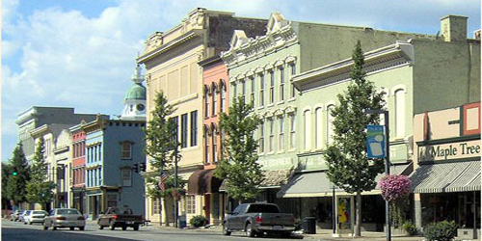
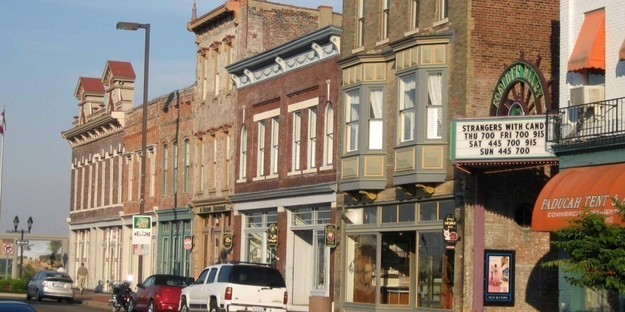
In FY2017 alone…
Kentucky had 26 projects successfully completed that earned a 20% federal tax credit with investments totaling $128,438,374.
KY ranked 13th nationally in the number of successfully completed projects.
Danville, KY
Paducah, KY
Rehabilitation Tax Credit Program
4
Notes:
Read text out loud…

Slide 5
What is a Tax Credit?
A tax credit is different than an income tax deduction.
An income tax deduction lowers the amount of income subject to taxation.
A tax credit, however, lowers the amount of tax owed. In general, a dollar of tax credit reduces the amount of income tax owed by one dollar.
Everyone’s tax status is different; we recommend anyone planning to undertake a tax credit project consult with their Tax Professional.
Rehabilitation Tax Credit Program
5
Notes:
Read text out loud…

Slide 6
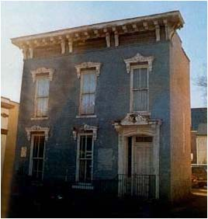
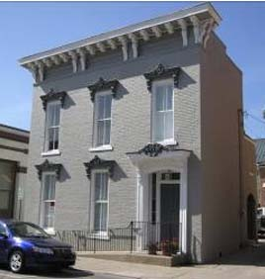
Federal Tax Credit
20% Tax Credit
for expenditures spent on a rehabilitation of Certified Historic Structure.
These credits are only available to income producing properties
There are no spending limits on this credit
It can’t be transferred / sold
Goodman Hs, Frankfort, KY
Rehabilitation Tax Credit Program
6
Notes:
To be eligible for federal tax credits the building must be income producing. It can be a commercial, industrial, agricultural, or rental residential property.
Read text out loud…

Slide 7
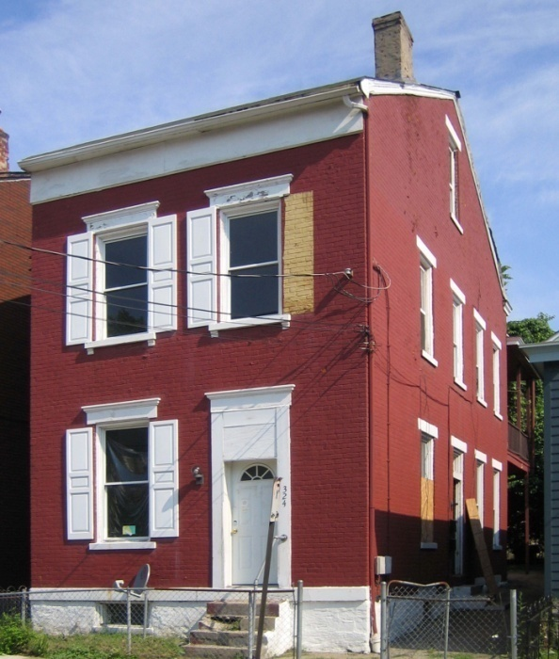
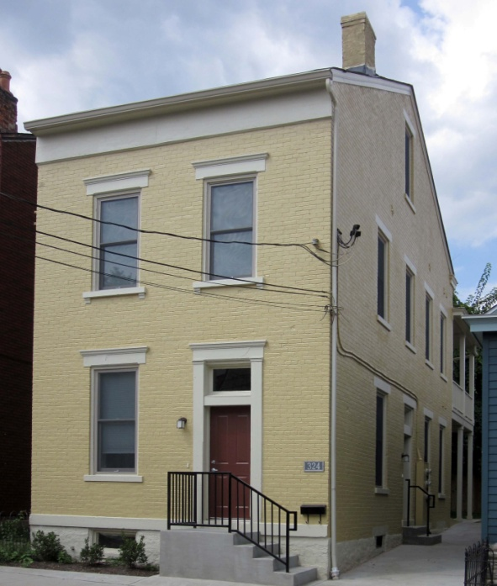
Federal 20% Credit
#1 – Your building has to be eligible (listed on the National Register)
#2 – You must make a substantial
investment in rehabilitating your
property
#3 – You must follow the Secretary
of the Interior Standards for
Rehabilitation
Covington, KY
Rehabilitation Tax Credit Program
7
Notes:
Read text out loud…

Slide 8
State Rehabilitation Tax Credits
Option A – 20% Tax Credit on expenditures spent on a Certified Rehabilitation of an income producing Certified Historic Structure
(just like the 20% Federal Tax credit and you can do both!)
Option B – 20% Tax Credit on expenditures spent on a Certified Rehabilitation of a Certified Historic Structure by a non-profit or local government.
Option C – 30% Tax Credit on expenditures spent on a Certified Rehabilitation of an owner occupied primary residence.
Rehabilitation Tax Credit Program
8
Notes:
Read text out loud…
The State tax credit is broader than the Federal credit.
If your project fits more than one of these options, you can pick whichever option gives you the greatest benefit. The Kentucky Heritage Council will be happy to help you determinate which tax credit option is best for you.
We will talk about this a bit more in a minute.

Slide 9
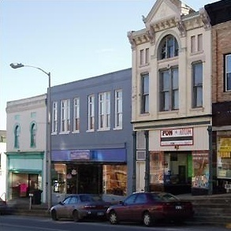
How is the State different than the Federal?
It ALSO covers owner occupied residences, non-profits, and local government projects.
$5 million cap each year
$60k cap per residential project
$400k per commercial project
Refundable
Winchester, KY
Rehabilitation Tax Credit Program
9
Notes:
The State credit is also different in a couple other ways…
There is a cap of $5 million that we can give out each year. If that limit is exceeded by approved projects, an apportionment formula will be applied to determine the credit amount.
There is also an individual cap of $60k for owner occupied residential projects and an individual cap of $400k on all other projects. This cap was put in place so that no single project would take the lions share of the state allocation pool.
The State credit is also refundable. Any credit that can’t be used against the current year’s taxes is issued as a tax refund check. And for non profits and local governments that don’t have tax liability, the credit is transferable to a financial institution.

Slide 10
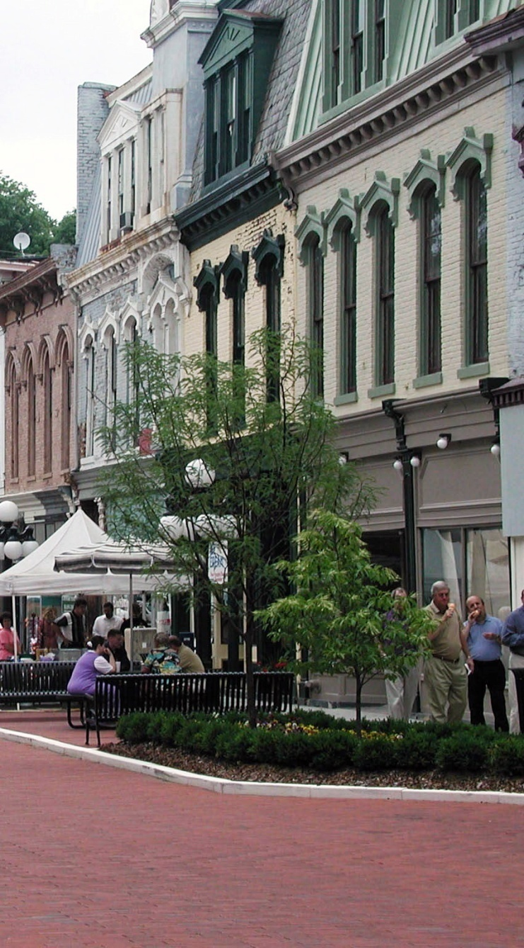
In 2017 alone…
Kentucky had 116 projects submitted
from 24 counties
46 for the 20% tax credit (commercial)
19 for the 20% tax credit (non-profit)
50 for the 30% tax credit (residential)
109 of these projects were approved pending completion of work.
These approved projects represent $78 million in proposed private investment for historic rehabilitation.
Frankfort, KY
Rehabilitation Tax Credit Program
10
Notes:
Read text out loud…

Slide 11
All of this is possible because of the National Historic Preservation Act
11
Notes:
Read text out loud…

Slide 12
NATIONAL HISTORIC PRESERVATION ACT - 1966
The spirit and direction of the Nation are founded upon and reflected in its historic heritage;
The historic and cultural foundations of the Nation should be preserved as a living part of our community life and development in order to give a sense of orientation to the American people;
It shall be the policy of the Federal Government to foster conditions under which our modern society and our prehistoric and historic resources can exist in productive harmony and fulfill the social, economic, and other requirements of present and future generations.
12
Notes:
Read text out loud…

Slide 13
Before we can talk about that, we have to talk briefly about our downtowns…
13
Notes:
Read text out loud…

Slide 14
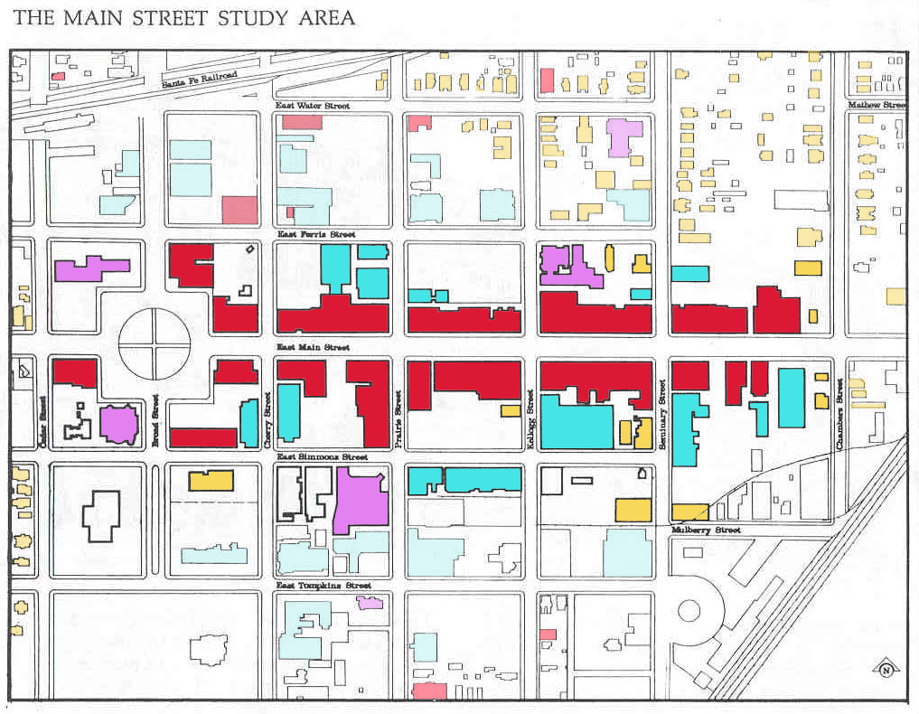
What Makes up our downtowns?
Core – Shopping
Retail
Restaurants
Axis – City Hall Public Square
Library
Post Office
Schools
Perimeter -
Apartments
House
Generic Town
14
Notes:
Read text out loud…

Slide 15
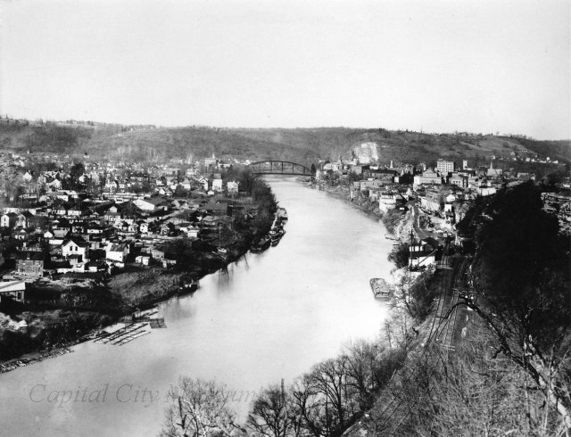
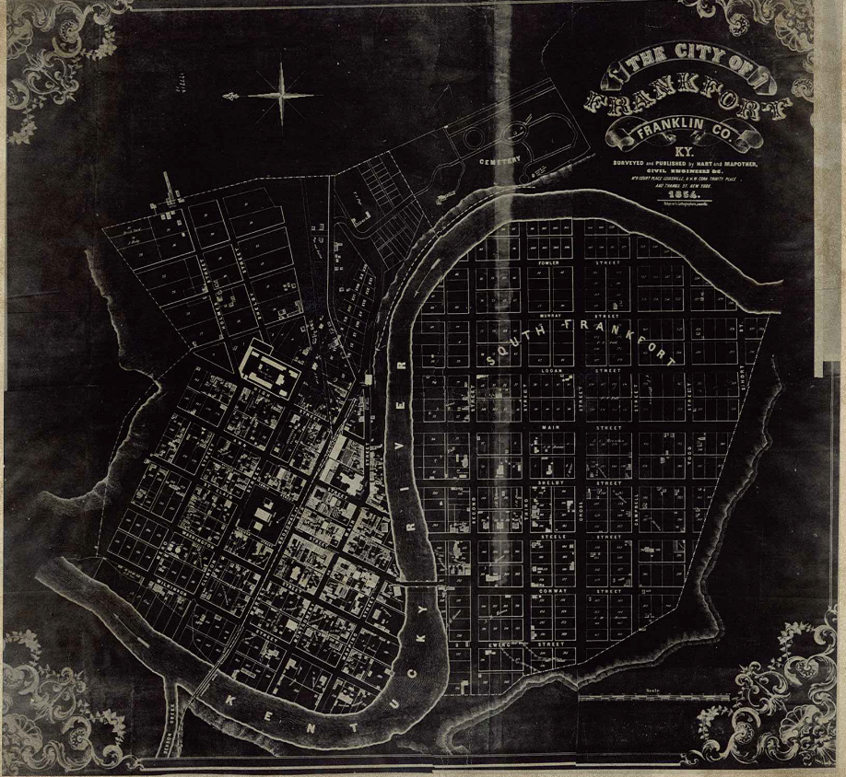
13
Notes:
This is a map and historic photo of our state capital in Frankfort, KY. As you can see, it is very dense to maximize the walkability for commerce and business.

Slide 16
How is downtown different than suburbia?
16
Notes:
Read text out loud…

Slide 17
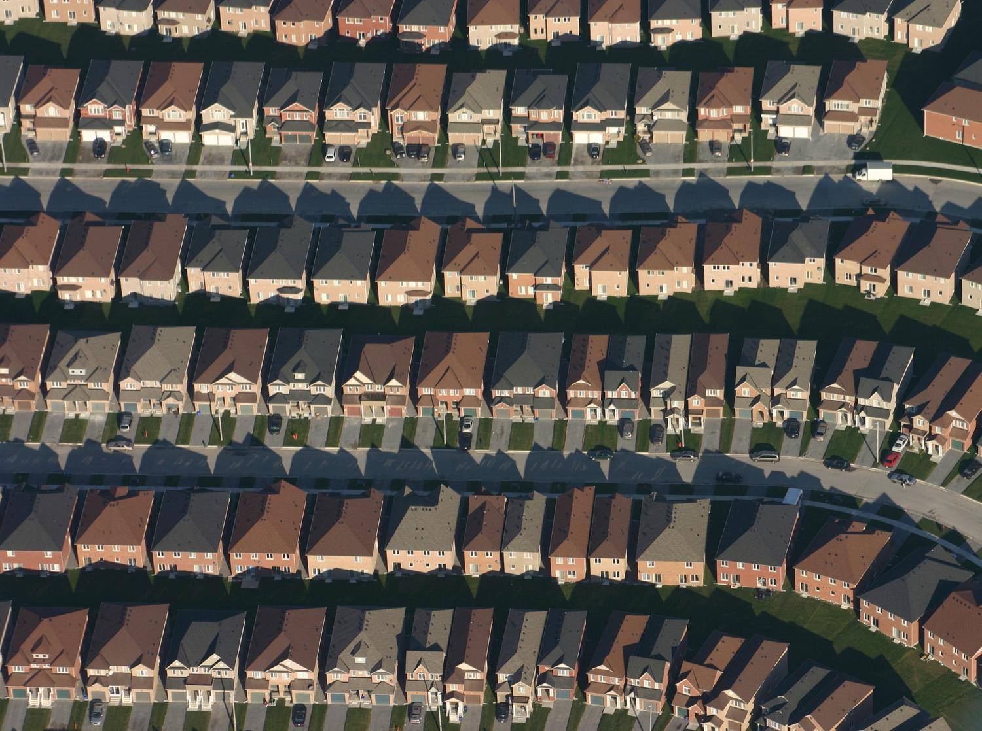
This is built for the car…
Notes:
Read text out loud…

Slide 18
This is built for the car…
18
Notes:
Read text out loud…
I have heard that this is our national flower, the cloverleaf…
Pause for laughter…

Slide 19
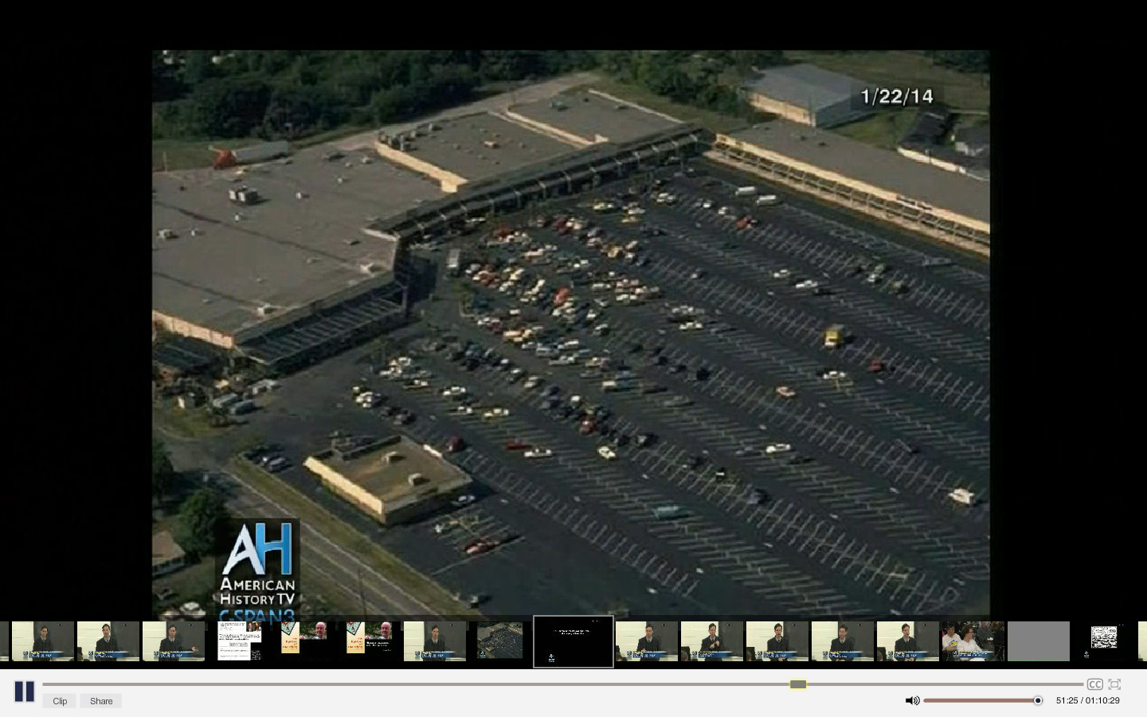
This is built for the car…
10
Notes:
Read text out loud…
While there may homes adjacent to this shopping center, it is impossible to get to on foot. There are no sidewalks. You would have to climb over chain link fences and drainage ditches to get there. It is designed to ONLY be accessible by car.

Slide 20
This is built for the car…
20
Notes:
While this is cartoon….

Slide 21
It isn’t just a cartoon…
21
San Antonio, TX
Notes:
Read text out loud…
This is San Antonio, TX but almost all cities in our country have these sprawling car-centric zones outside our downtowns.

Slide 22
This is built for people…
Danville, KY
22
Paducah, KY
Notes:
In contrast to those car centric zones, this is what our historic downtowns look like.
Read text out loud…

Slide 23
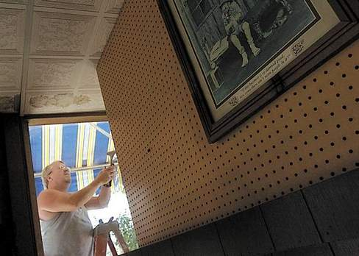
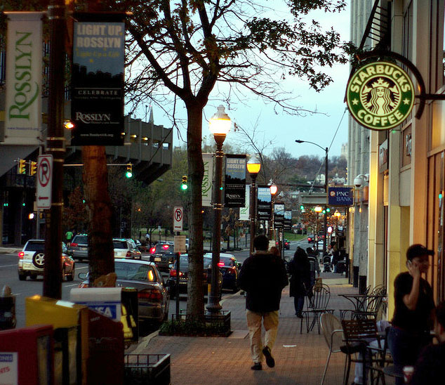
This is built for people…
Ahland, KY
23
Rosslyn, GA
Notes:
Read text out loud…

Slide 24
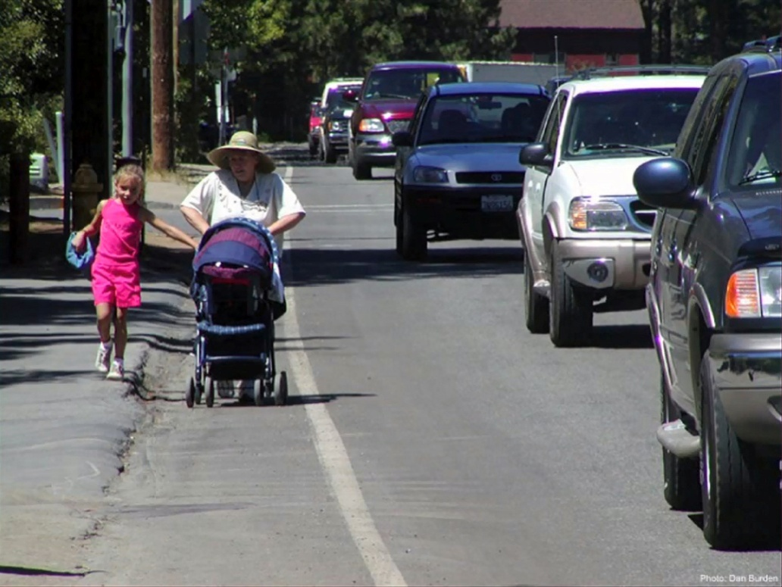
Surrounding our downtowns
are places we call “sprawl”….
In these areas, pedestrians are marginalized and sidewalks go no-where or don’t exist at all.
24
Notes:
Read text out loud…

Slide 25
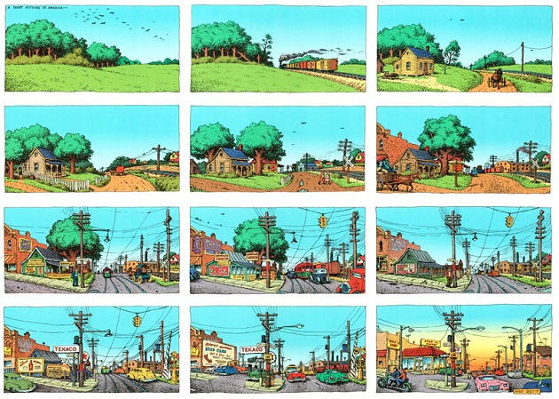
Typical path of development outside of cities
25
Art by R. Crumb
Notes:
Read text out loud…

Slide 26
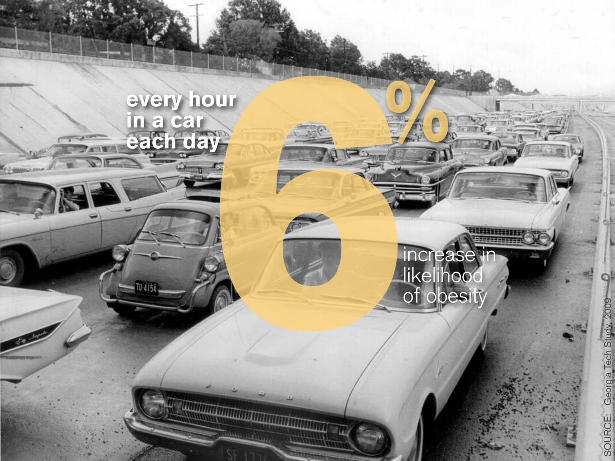
I think it is worth mentioning this too….
26
Notes:
Read text out loud…

Slide 27
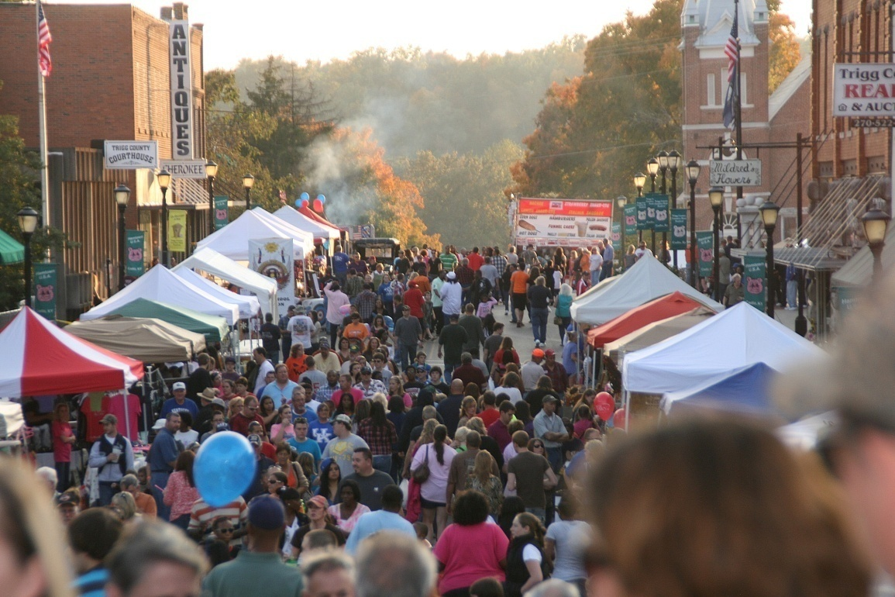
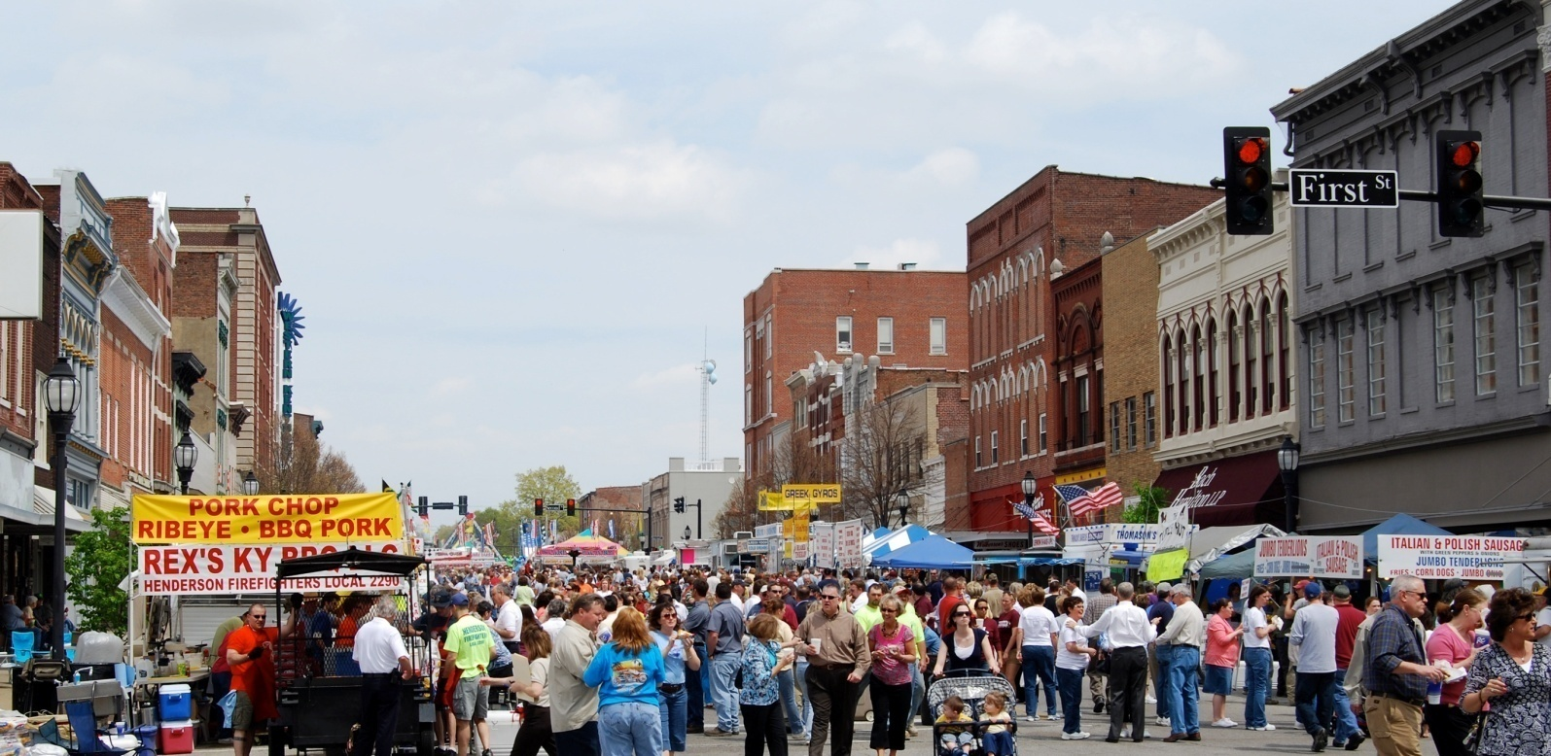
Don’t get me wrong, I don’t want to ban cars from the downtown.
Cadiz, KY
Henderson, KY
But there needs to be a healthy balance
with a focus on pedestrians.
27
Notes:
Read text out loud…

Slide 28
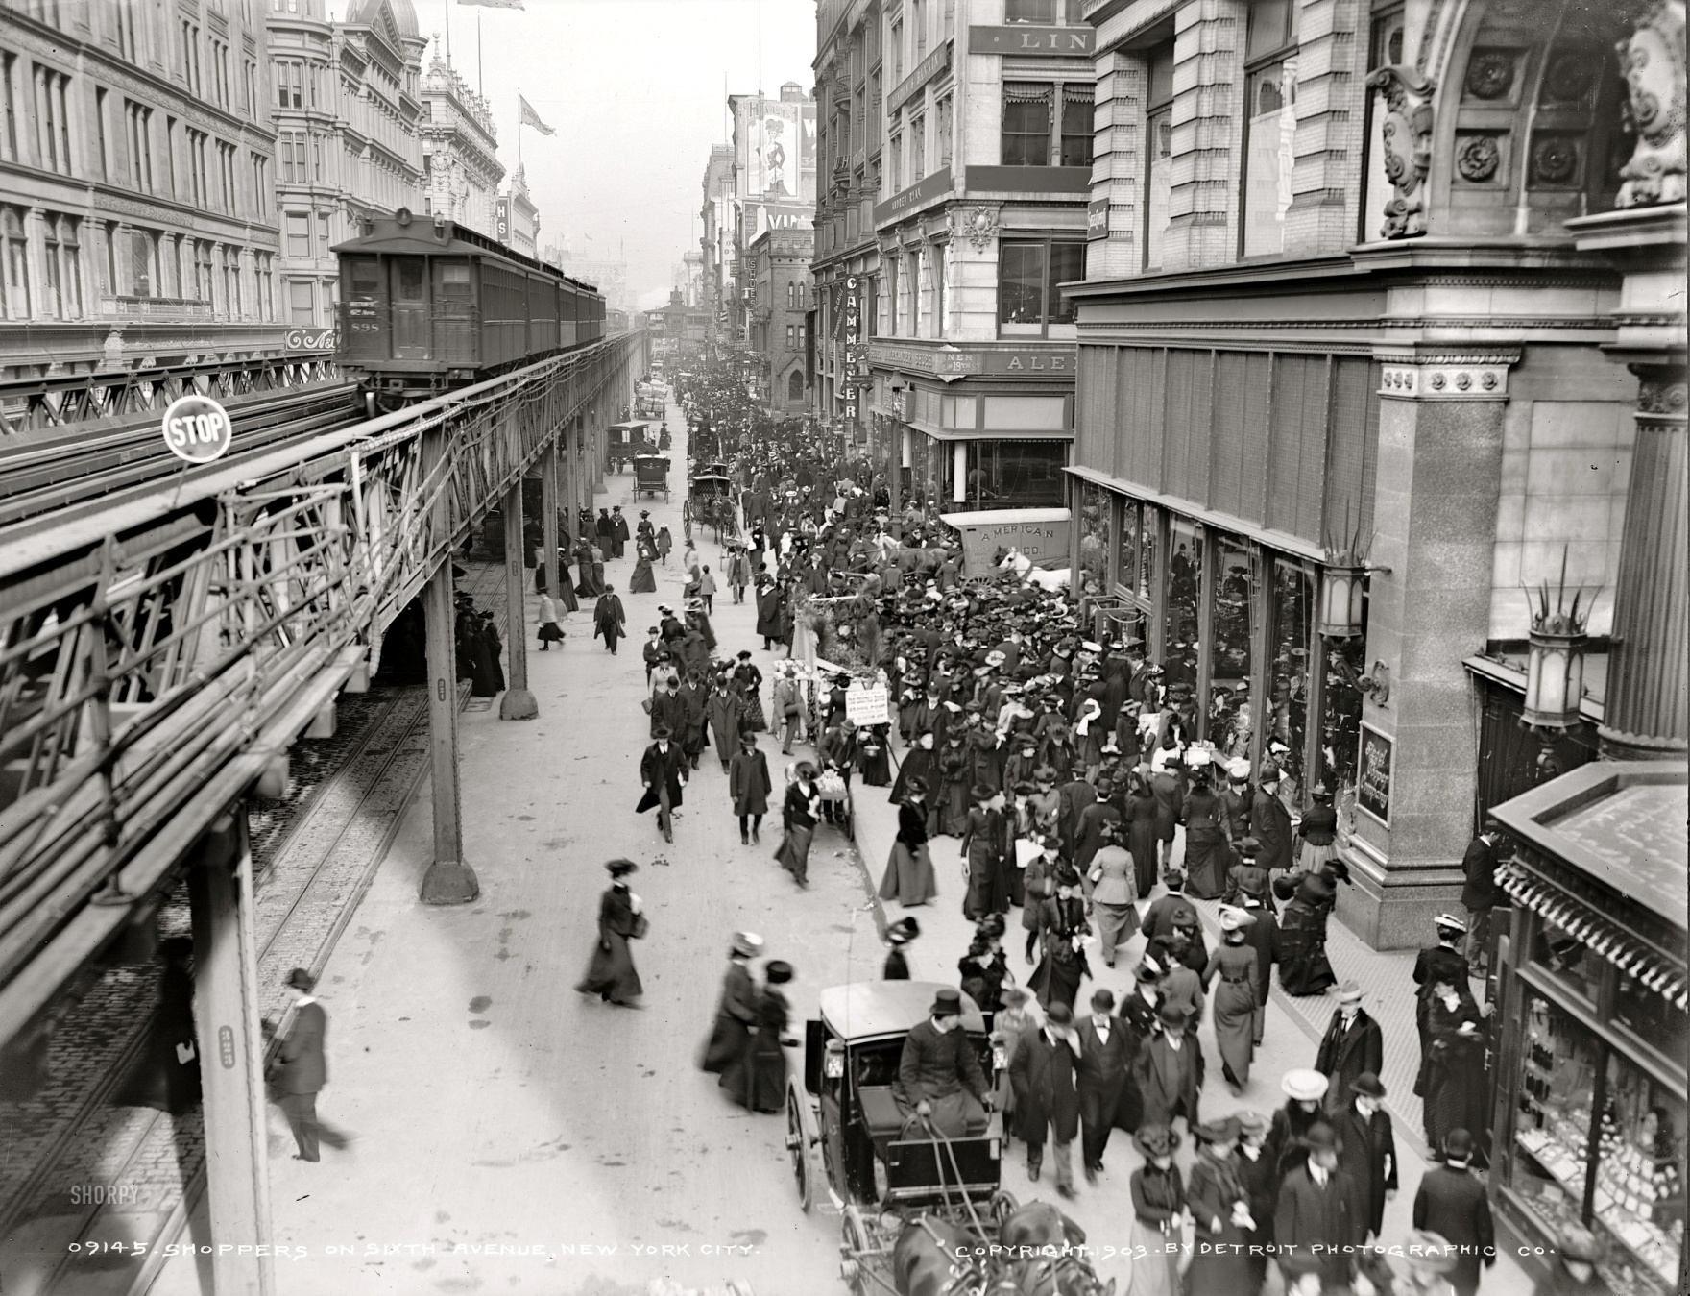
Before cars were king, this is how pedestrians inhabited our downtowns
28
Chicago
Notes:
Read text out loud…
As you can see, horse drawn transportation were distinctly second class. And in Chicago and some other major cities, public transportation had its own dedicated path that didn’t intersect with the pedestrians.

Slide 29
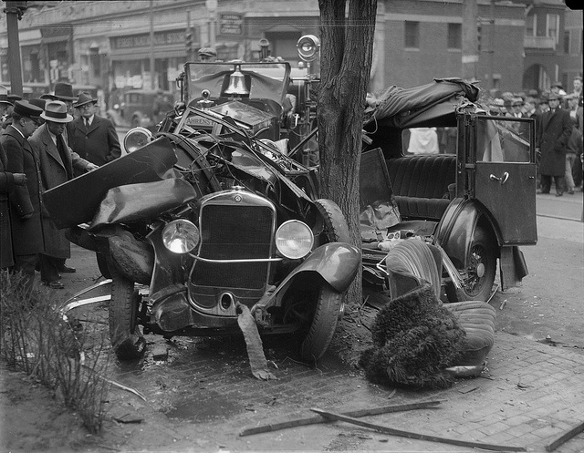
Then the car came along…
29
Notes:
Read text out loud…
Pause for laughter

Slide 30
Across the country in the 60s, highways started doing this to our cities….
Peter Norton
10
Notes:
Read text out loud…
Right after WW2, we started building highways across the entire country. Many city mayors started to be concerned that if these highways didn’t connect into their cities, that they would lose people, jobs, and economic opportunities.
Then someone had the “bright” idea that you could kill two birds with one stone, if you ran these highways through the most blighted parts of your town.
Unfortunately, what one person might consider “blighted”, another person might consider to be beautiful historic buildings. Often, these were minority communities. Other times, they were disused commercial areas. Cincinnati and Louisville are examples where riverfront warehouses were all torn down to make way for these highways.
Half a century later, Cincinnati has spent millions and millions of dollars trying to undo this decision and reconnect its city back to its waterfront.
And as these highways destroyed historic building after historic building all across our country, citizens become upset and demanded that the government change this.

Slide 31
Which brings us back to this…
31
Notes:
Read text out loud…

Slide 32
NATIONAL HISTORIC PRESERVATION ACT - 1966
The spirit and direction of the Nation are founded upon and reflected in its historic heritage;
The historic and cultural foundations of the Nation should be preserved as a living part of our community life and development in order to give a sense of orientation to the American people;
It shall be the policy of the Federal Government to foster conditions under which our modern society and our prehistoric and historic resources can exist in productive harmony and fulfill the social, economic, and other requirements of present and future generations.
32
Notes:
Read text out loud…

Slide 33
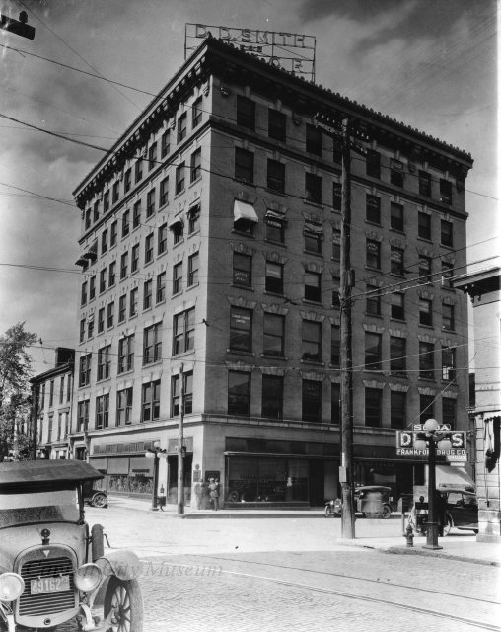
1986 Tax Reform Act
Congress instituted the Tax Credit incentive under the 1986 Tax Reform Act which created this 20% credit for the rehabilitation of historical buildings
Rehabilitation Tax Credit Program
8
Notes:
Read text out loud…
The State credit is also different in a couple other ways…
There is a cap of $5 million that we can give out each year. If that limit is exceeded by approved projects, an apportionment formula will be applied to determine the credit amount.
There is also an individual cap of $60k for owner occupied residential projects and an individual cap of $400k on all other projects. This cap was put in place so that no single project would take the lions share of the state allocation pool.
The State credit is also refundable. Any credit that can’t be used against the current year’s taxes is issued as a tax refund check. And for non profits and local governments that don’t have tax liability, the credit is transferable to a financial institution.

Slide 34
What do I have to do
to get this money?
34
Notes:
Pause to allow audience to read this text…
I think this is the question everyone here wants to know… ☺
It is actually pretty simple. There are three requirements…

Slide 35
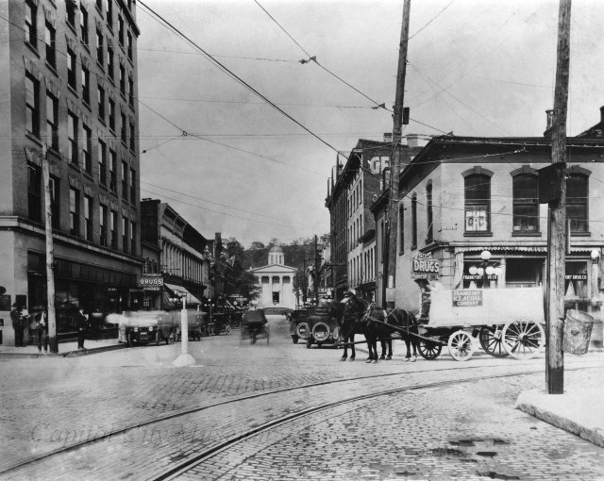
Historic Tax Credit Requirements
#1 – Your building has to be
eligible
#2 – You must make a
substantial investment in
rehabilitating your property
#3 – You must follow the
Secretary of the Interior
Standards for Rehabilitation
Rehabilitation Tax Credit Program
35
Notes:
Read text out loud…
We will got through each of these one by one.

Slide 36
#1 - Is my building eligible?
To be eligible, it needs to be EITHER….
Listed individually on the National Register
OR… be a certified contributing part of a National Register Historic District.
The Federal Tax Credit program has a process for properties not currently listed, the state tax credit does not.
#1 – Your building has to be eligible
36
Notes:
Read text out loud…
You can call or email me and I will be happy to confirm your National Register status.
If you find that your building is not on the National Register, you may want to look into putting on the National Register. And there is someone in our office that can help you with that.

Slide 37
What is the National Register?
The National Register is the nation’s official list of resources deemed worthy of preservation.
The National Register recognizes districts, sites, buildings, structures and objects significant in American history, architecture, archaeology, engineering and culture.
Kentucky ranks 4th in the nation in number of listings on the National Register of Historic Places
#1 – Your building has to be eligible
37
Notes:
Read text out loud…
It is important to note that National Register districts are different than local historic districts, Mainstreet districts, or historic overlay districts. Each of these districts have distinct boundaries. Sometimes these district boundaries overlap but other times they do not.
So it is important to talk to us to verify your building’s status.

Slide 38
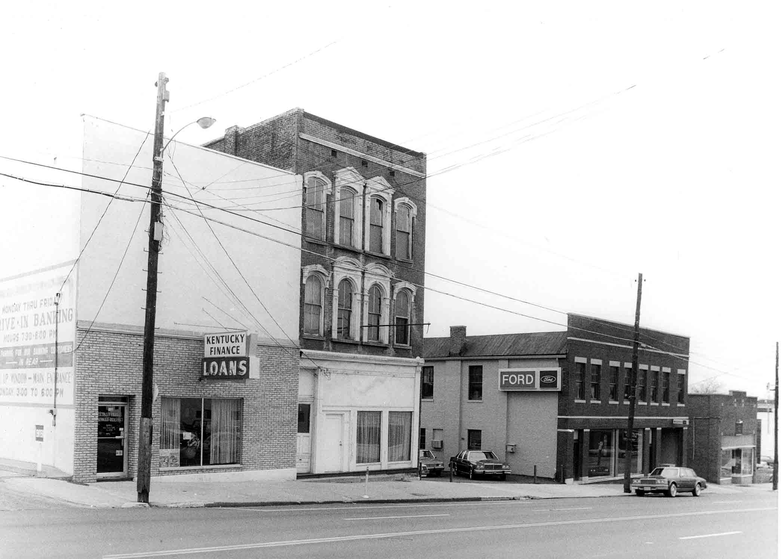
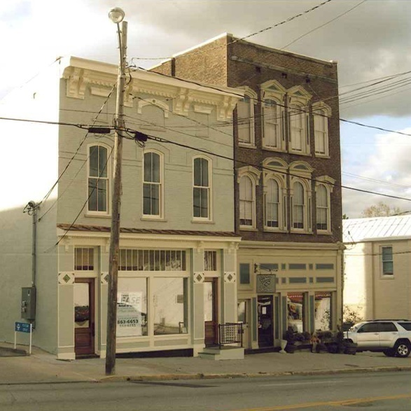
National Register Criteria
A building can be placed on the National Register if it is…
1 – Old enough
2 – Significant enough
3 – Intact enough
If the building is already in a NR historic district, you can get the 20% credit if the building is…
1 – Listed as contributing OR
2 –Old and Intact enough
Georgetown, KY
#1 – Your building has to be eligible
38
Notes:
Read text out loud…
Sometimes, buildings have been covered with a newer facade that obscures the historic fabric of the building. In this case, we may require that this non-historic element be removed to see what exists underneath it, before determining if the building is eligible.

Slide 39
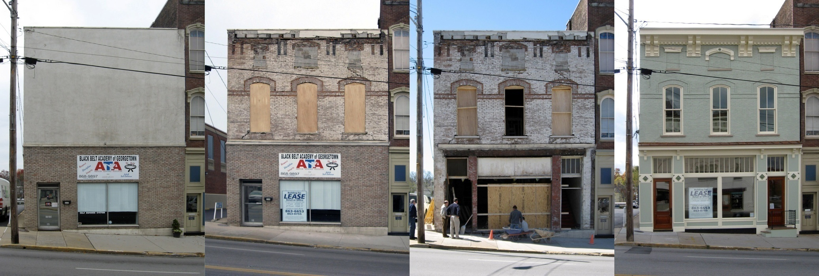
Rehabilitation Standard
Georgetown, KY
#1 – Your building has to be eligible
39
Notes:
This is a great example of a building that has had a lot of changes done to it over the years. But like a lot of downtown buildings, it was actually in better shape and had more historical integrity than you might expect… hidden underneath.
When the owner submitted the photo on the far left, he expected to be told that he didn’t have enough intactness to qualify. But we told him to remove the non-historic “slip cover” on the second floor and low and behold, there was a lot of historic fabric (next image – center left). You can see the ghost locations of the cornice brackets…. Which gave the owner enough information to be able to recreate this element.
In general, contractors don’t want to spend a lot of money tearing things off and hauling them away. And often, these slip covers have aged badly and are starting to fall apart anyway. This one was removed in only a couple hours.
With the assurance that he was now eligible for the credit, he removed the non-historic brick covering at the first floor, and low and behold, there was even more historic fabric (center right).
And the photo on the right shows the beautifully restored building that was hidden under that terribly muddled up first photo.
If you have a muddled up building like this, likely it has been this way for decades and it is hard to imagine that it ever looked any other way. I highly recommend that you go find a historic photo of your building. This is a great way to gain some confidence about how amazing your building could look after it is restored.

Slide 40
#2 – What is a substantial investment?
Kentucky’s owner-occupied residential credit requires $20k in eligible expenditures within a 24 month period
Kentucky’s credit for non-profits or local governments also requires $20k in eligible expenditures within a 24 month period
For commercial properties, both Kentucky and the Federal credit require that you spend either $20k or the adjusted basis, whichever is higher.
#2 – Making a substantial investment
40
Notes:
A substantial investment is just what it sounds like. We want you to put a significant amount of money into renovating your building. More than just a coat of paint or a new awning. But the minimum amount of money required to qualify for this credit depends on the type of project.
Read text out loud…
In some cases, just adding a new roof or a new mechanical system will allow you to meet this requirement.

Slide 41
What is “The Adjusted Basis”?
This is an accounting term…
The adjusted basis of a building is the cost of the property (excluding land) plus or minus adjustments to basis. The County Assessor's office would be able to provide a building to land value ratio. Increases to basis include capital improvements, legal fees incurred in perfecting title, zoning costs, etc. Decreases to basis include deductions previously allowed or allowable for depreciation. See Treasury Regulation 1.48- 12(b)(2)(iii).
Basically, this is the purchase price of the building, minus the cost of the land, plus any past improvements minus any depreciation you have taken on the building since you have owned it.
#2 – Making a substantial investment
41
Notes:
What is the adjusted basis?
Let me be clear that I studied Architecture and not Accounting. I know just enough to be dangerous. Everyone’s tax status is different. Anyone planning to undertake a tax credit project should consult with a Tax Professional. With that disclaimer…
Read text out loud…
For example…

Slide 42
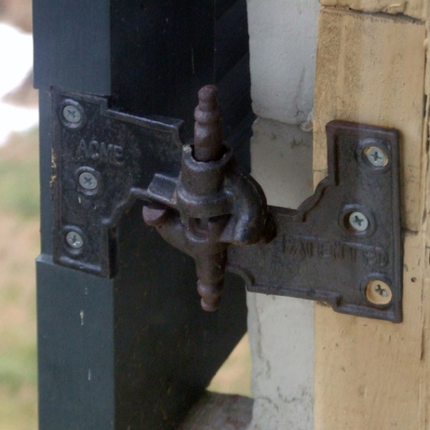
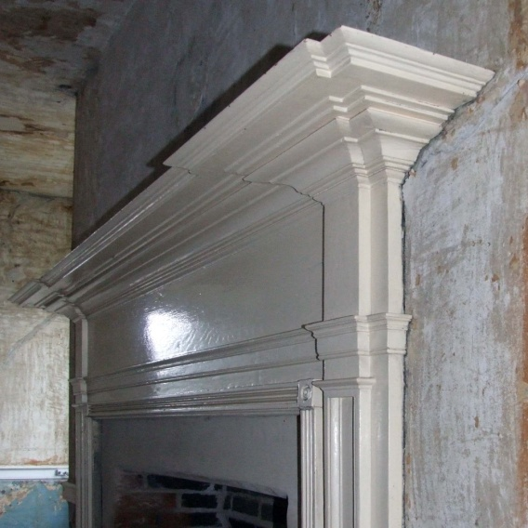
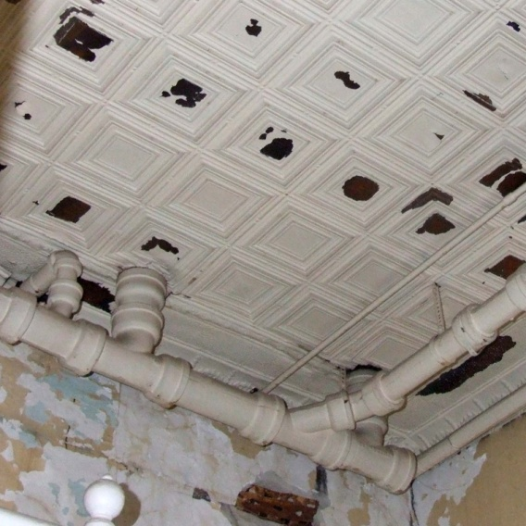
What expenditures are eligible?
Anything for your historic building!
This includes new mechanical systems, roofs, plumbing, wiring, lighting, chimneys, stairs, elevators, sprinkling systems, fire escapes, walls, floors, ceilings, and even painting.
It is also "soft costs" like architect, engineering and developer fees.
Squire Erick Hs, Louisville, KY
Marine Hospital, Louisville, KY
#2 – Making a substantial investment
42
Notes:
Read text out loud…

Slide 43
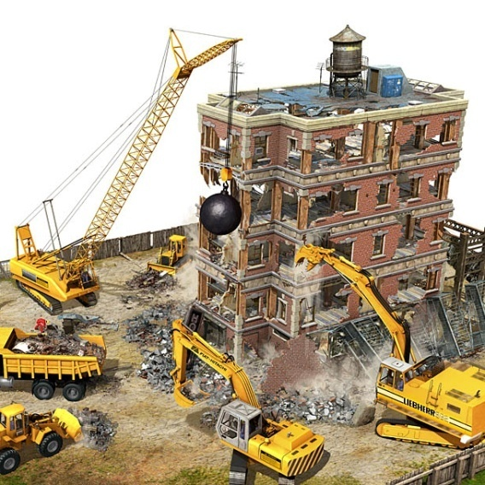
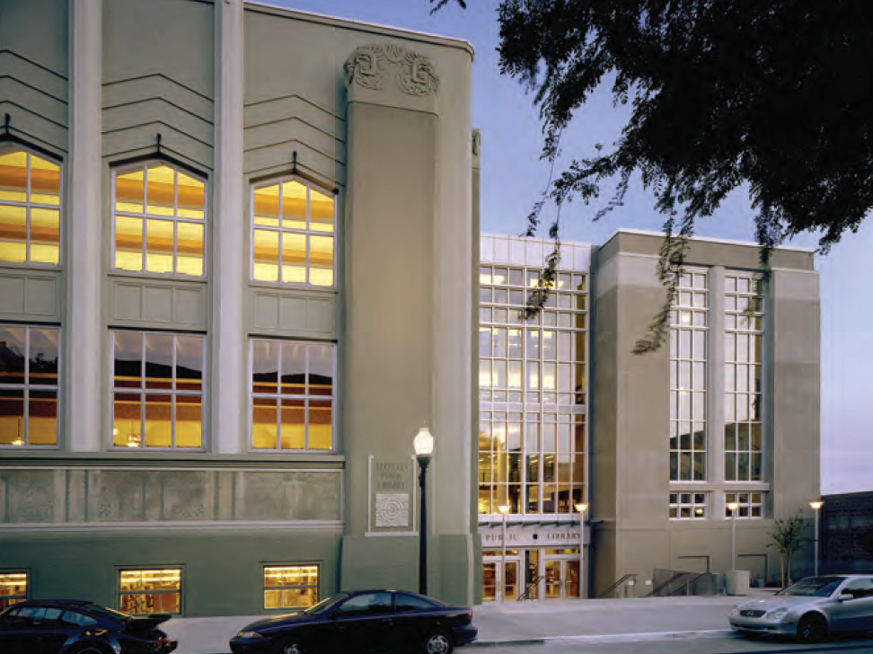
What expenditures aren’t eligible?
New additions or new building costs
Demolition costs
Parking lots or sidewalks
Retaining walls or fencing
Landscaping
Acquisition costs
Non permanent items like
appliances, cabinets
or carpeting
#2 – Making a substantial investment
43
Notes:
Read text out loud…
When I was putting this slideshow together, I would like to tell you that it was REALLY hard to find a picture of a historic building being demolished. Sadly, there were so many of them that it was hard chose which one was the worst.
These two images are also a great lead in for the third requirement to be eligible for these Tax Credits. You must following the Secretary of the Interior Standards (which neither of these images do).

Slide 44
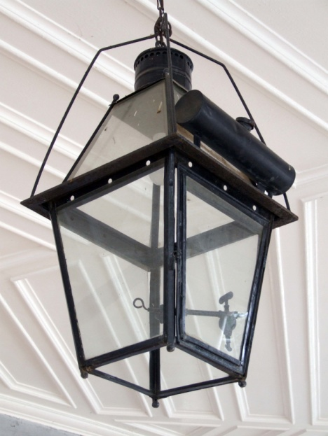
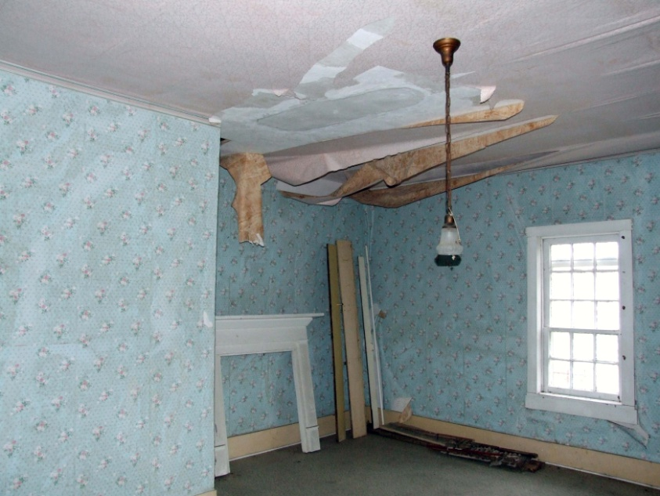
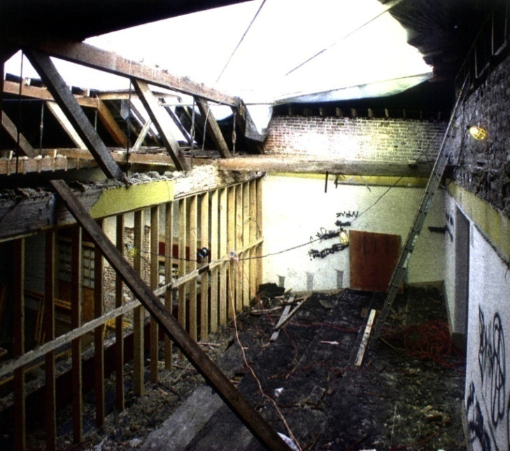
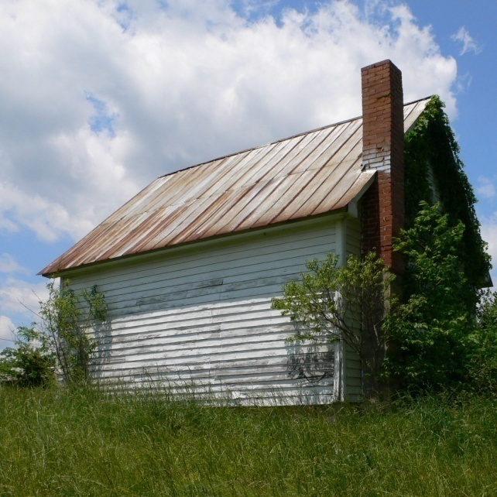
#3 – You have to follow the Standards
The NPS has four different standards, but the Rehabilitation Standard is the one that must be followed for State and Federal Tax Credits…
#3 – Following the Standards
44
Notes:
Remember that I said that there were three requirements? This is #3, that you need to follow the Secretary of the Interior Standards!
Read text out loud…

Slide 45
Preservation - focuses on the maintenance and repair of existing historic materials and retention of a property's form as it has evolved over time. (Protection and Stabilization have now been consolidated under this treatment.)
Restoration - depicts a property at a particular period of time in its history, while removing evidence of other periods.
Reconstruction - re-creates vanished or non-surviving portions of a property for interpretive purposes.
Rehabilitation - acknowledges the need to alter or add to a historic property to meet continuing or changing uses while retaining the property's historic character.
#3 – Following the Standards
45
Notes:
Historic properties can be worked on using any one of these four treatments.
The Preservation Standard is a way to mothball a building.
The Restoration Standard is typically used for strict museum-level restoration.
The Reconstruction Standard is used when a portion of a building has been lost and is being rebuilt.
The last one, the Rehabilitation Standard is the one that most property owners will chose. It says…
Read text out loud…

Slide 46
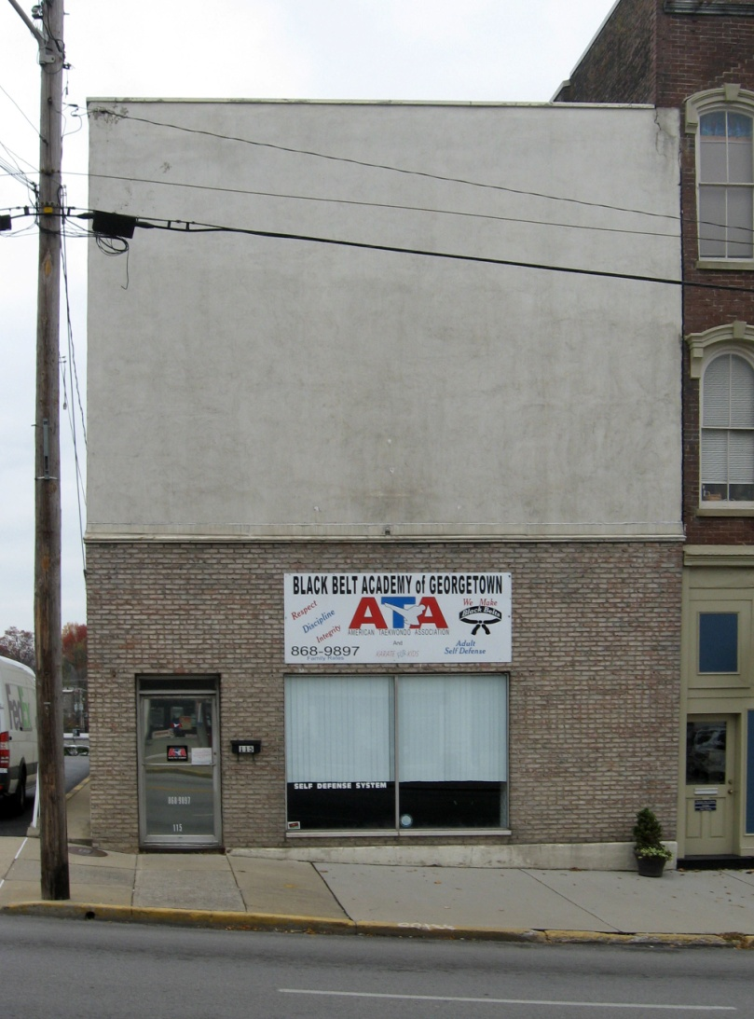
Rehabilitation Standard
Rehabilitation is…
The process of returning a property to a state of utility, through repair or alteration, which make possible an efficient contemporary use while preserving those portions and features of the property which are significant to its historic, architectural, and cultural values.
Georgetown, KY
#3 – Following the Standards
46
Notes:
Read text out loud…
We understand that historic properties don’t always work for modern day uses. 100 years ago, houses didn’t have bathrooms in them. Obviously, we don’t expect you remove all your plumbing and install outhouses. Instead, this standard allows you to modify your building so that it meets your current needs while preserving the important historic elements of your building.

Slide 47
Ten points in the Rehabilitation Standard
Property shall be used for its historic purpose or be placed in a new use that requires minimal change to the defining characteristics.
Historic character of a property shall be retained and preserved.
New changes that create a false sense of historical development shall not be undertaken.
Existing changes that have acquired historic significance in their own right shall be preserved.
Distinctive features, finishes, and construction techniques that characterize a historic property shall be preserved.
Deteriorated historic features shall be repaired rather than replaced.
Treatments that cause damage to historic materials shall not be used.
Significant archeological resources shall be protected and preserved.
New additions shall not destroy historic materials that characterize the property. New work shall be differentiated from the old.
New additions shall be done in such a manner that if removed in the future, the essential form and integrity of the historic property and its environment would be unimpaired.
#3 – Following the Standards
47
Notes:
There are ten points in the Rehabilitation Standard.
You don’t need to strain your eyes reading these because we are going to go through them one by one…

Slide 48
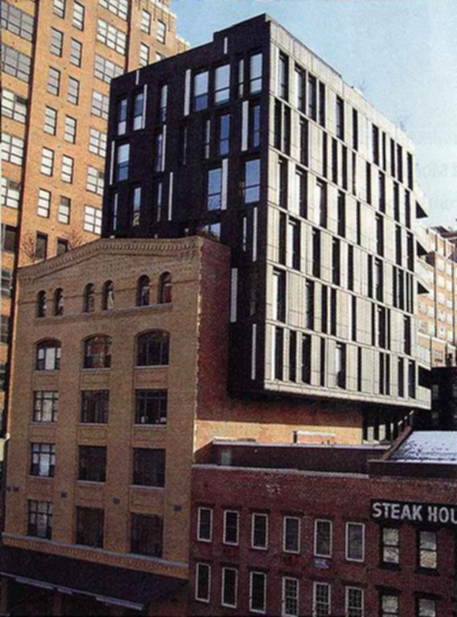
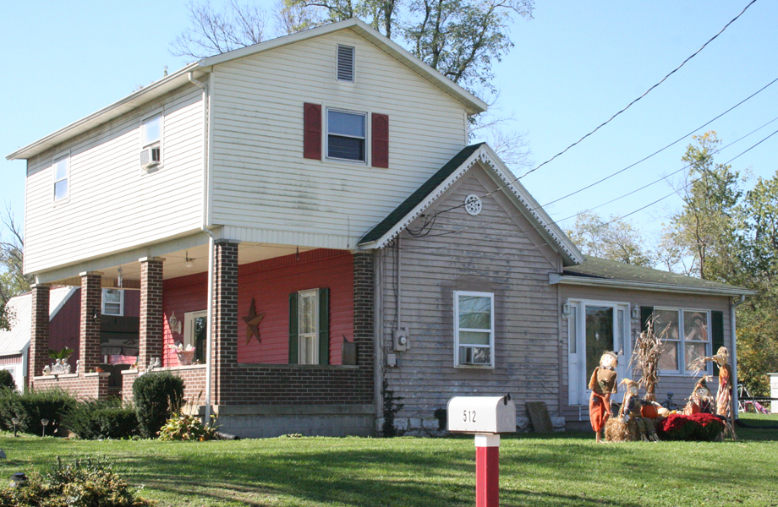
#1 - Property shall be used for its historic purpose or be placed in a new use that requires minimal change to the defining characteristics.
New York City, NY
#3 – Following the Standards
48
Notes:
Read text out loud…
As you can see, neither of these is a good example of maintaining the historic character of the building.

Slide 49
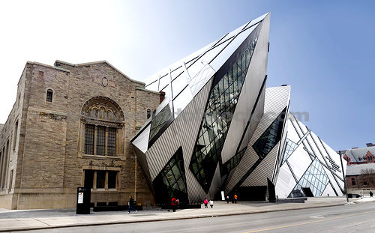
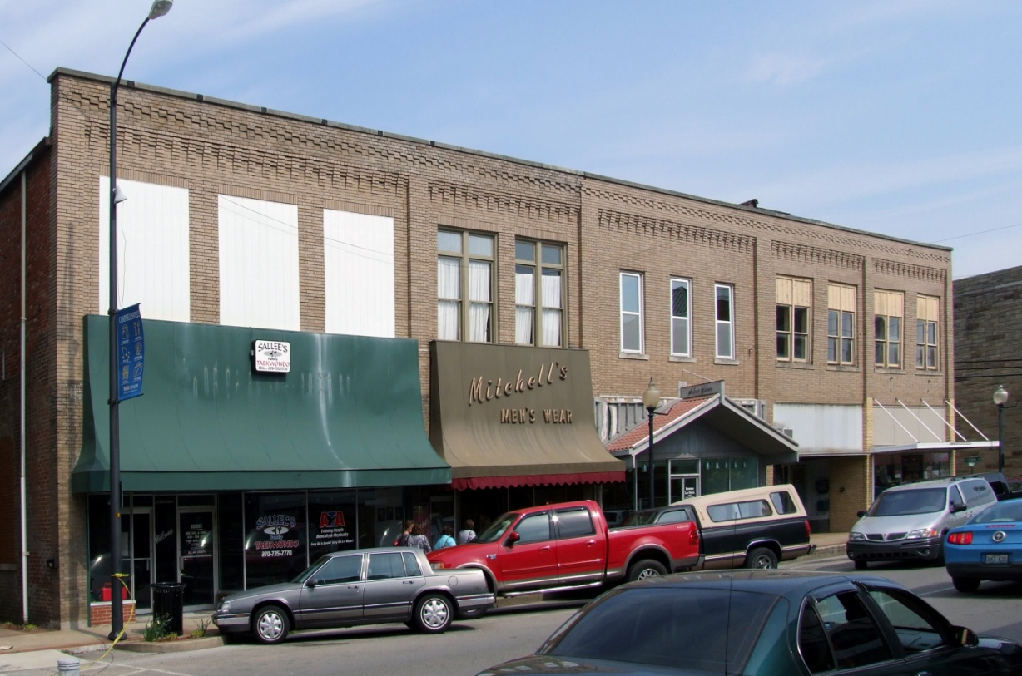
#2 - Historic character of a property shall be retained and preserved.
Libskinbd Architects
Campbellsville, KY
#3 – Following the Standards
49
Notes:
Read text out loud…
The building on the right is designed by Libskinbd Architects. You might be familiar with the tower they build near Cincinnati adjacent to the Covington waterfront. In Kentucky, we generally don’t have this kind of problem with our historic buildings.
But the photos on the left shows the kind of changes that have happened to many of our downtown buildings. You can see where windows have been boarded up, window openings throated down, new inappropriate canopies added, etc.
The cumulative effect of all of these changes add up to something as profound as what we see on the right. Luckily it isn’t that hard to take off those awful canopies and put windows back that match the historic configurations.

Slide 50
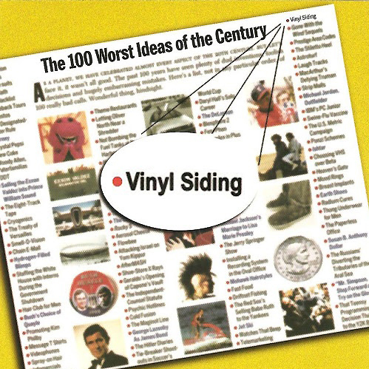
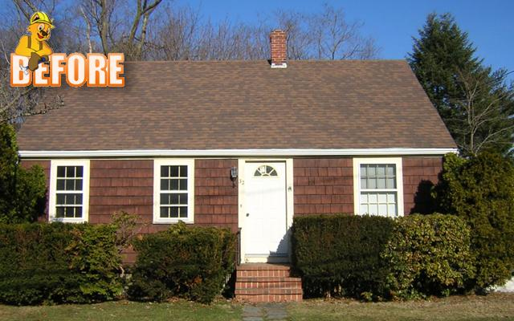
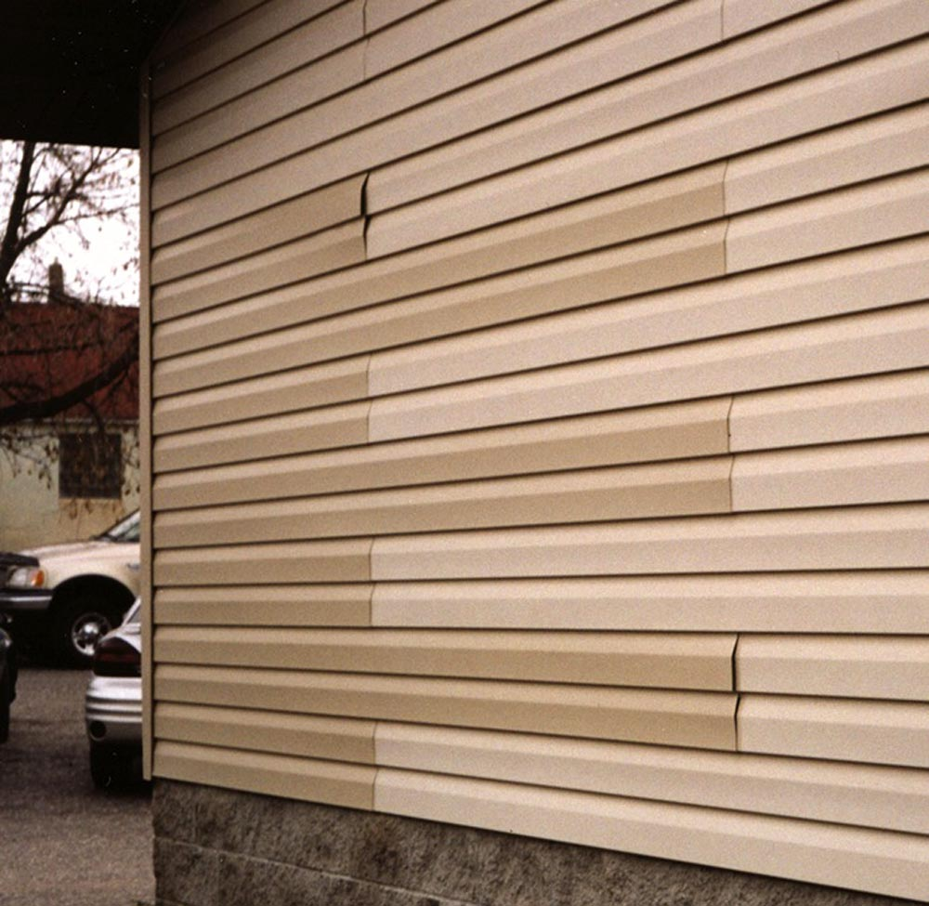
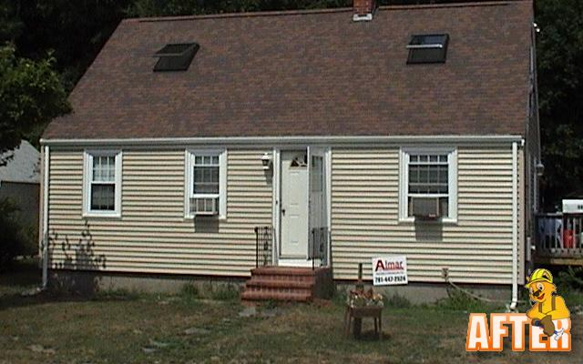
#3 – Following the Standards
50
Notes:
These images come from a Vinyl siding company’s website. This is one of their “best” examples of what vinyl can do for your buildings.
As you can see, much of the character of the building has been “lost”.

Slide 51
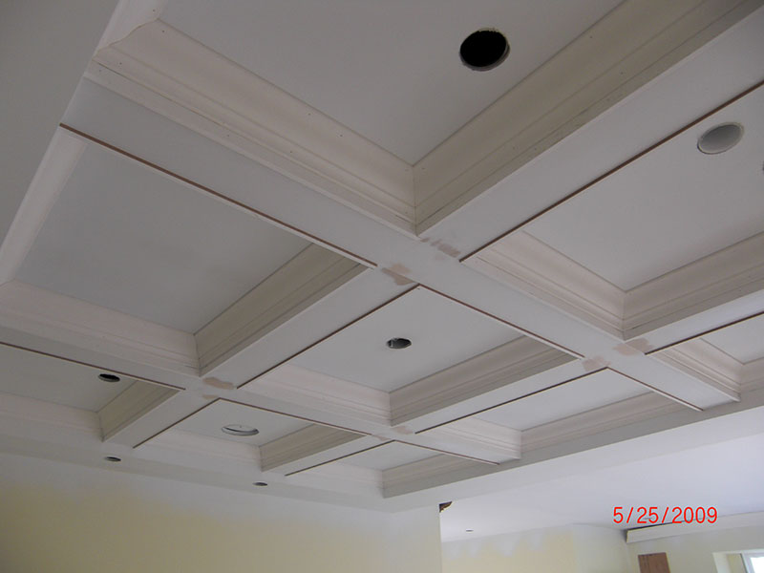
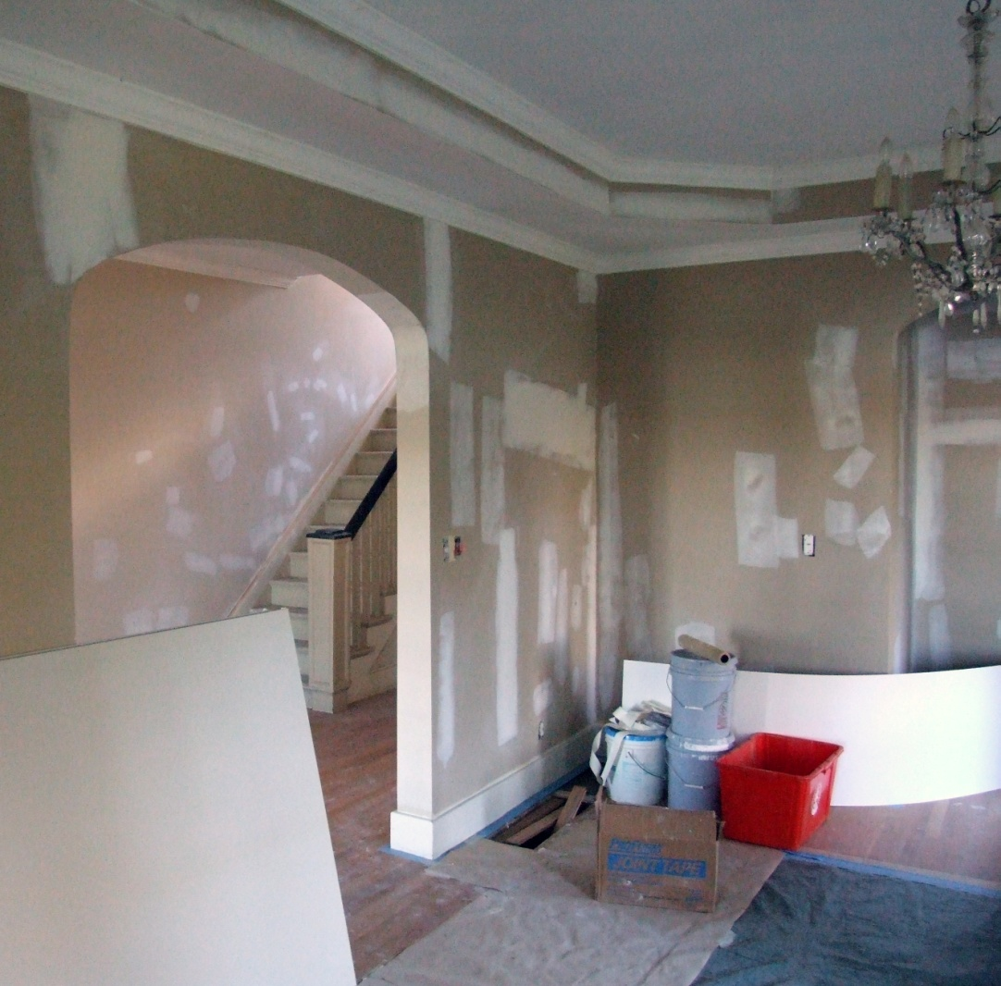
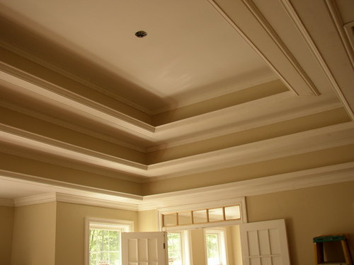
#3 - New changes that create a false sense of historical development shall not be undertaken
#3 – Following the Standards
51
Notes:
Read text out loud…
If your building has simple plaster corners at the ceiling without crown mold, we don’t want you to add crown mold or tray ceilings or faux beams.
The details your house historically has are important character defining features and we want you to keep and maintain them, not create this false sense of history.

Slide 52
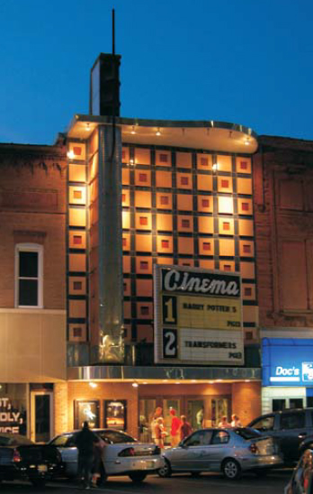
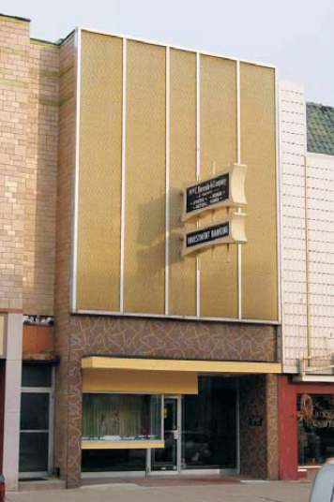
# 4 - Existing changes that have acquired historic significance in their own right shall be preserved.
#3 – Following the Standards
52
Notes:
Read text out loud…
For those of you that are old enough to remember when these changes were made back in the 50s or 60’s, this might be a tough one to wrap your head around. It might not feel like these changes have gained significance. And you are probably thinking about that earlier project with a slipcover on it and asking why these slipcovers are different. It is important to distinguish between the two and there a couple factors that we look at. One is whether the new façade has a high level of artistic or architectural design. Another factor is the condition of the new façade and the condition of the façade underneath it. In some cases, a tremendous amount of the original façade has been lost. In other cases, even if the new façade is very highly designed, it might be failing and can’t be repaired. And while we can’t always accommodate it, we also want to know which façade the owner wants to keep.
If you have a building like this, it is worth talk to us early on in your design process so we can help clarify which façade should be maintained and repaired.

Slide 53
#5 - Distinctive features, finishes, and construction techniques that characterize a historic property shall be preserved
Varnished wood should remain unpainted
#3 – Following the Standards
53
Notes:
Read text out loud…
It is hard to believe that someone would have beautiful varnished wood like this and want to paint it. But here is an example of just that.
If you have varnished wood, we want you to maintain it and not paint it. Even if half of the woodwork in the building is painted, we want the portion that is unpainted to stay unpainted. And of course, you are always welcome to remove paint done by previous owners, but we don’t require this.

Slide 54
#6 - Deteriorated historic features shall be repaired rather than replaced.
Original
Not approvable
Approvable
Replacement
Beecher Hotel – Somerset, KY
#3 – Following the Standards
54
Notes:
Read text out loud…
You can see in this photo how the first floor and 4th and 5th floor windows are original but the 2nd and 3rd floor windows were replaced with very bad vinyl windows.
This is a case where the first floor windows with their arch tops were too complicated to replace and the contractors or owners got tired of walking up the stairs and never got around to replacing the upper windows.
We want you to keep your historic windows. But where windows have been replaced by previous owners, it is acceptable to re-replace them. We just want the replacements to be really close matches to the historic profiles. In order to be approved, the windows have to be a close enough match that you can’t tell which are the replacement and which are the original windows from a couple feet away.

Slide 55
After
Before
Beecher Hotel – Somerset, KY
#3 – Following the Standards
55
Notes:
What a difference the correct windows make!
On the right photo, you can see how those awful 2nd and 3rd story windows have been replaced with appropriate new windows.
They say that your eyes are the windows to your soul. Likewise, your building’s windows are a big part of the character of your buildings.

Slide 56
#3 – Following the Standards
56
Notes:
If you are like me, you have been inundated with ads every Saturday afternoon telling you to replace your windows and how energy efficient new windows are compared to your leaky drafty historic windows.
I hate to tell you but those replacement window companies are cherry-picking their facts.
They call replacement windows, “replacement windows” because you have to keep replacing them, typically every 20 years. And if it takes 34 to 240 years to pay for the window in energy savings, but you have to re-replace them every 20 years, they will never pay for themselves. Conversely, we have very good data that shows that if you repair your wood window, caulk it, and install a good gasketed storm window, your historic window will get the same energy efficiency as a replacement window!
And this historic window, which is some cases is already a hundred years old, can last another 100 years with proper maintenance.
So even if you aren’t a preservationist, the math is pretty clear. Keep your historic windows!

Slide 57
Three Tier Approach
1 – Leave historic elements alone
2 – If a historic element is broken, fix it gently
3 – If a historic element is too badly damaged to be fixed, replace it with something similar.
When you submit your description of proposed work, we will review it to make sure it will meet these standards.
If you do the work you described and follow any conditions we put on your scope of work, you get these tax credits!
#3 – Following the Standards
57
Notes:
Read text out loud…
We want you to get this tax credit and will work with you to make sure that the work you do is eligible for these tax credits.

Slide 58
#7 - Treatments that cause damage to historic materials shall not be used.
Spalling brick
Sand blasted brick
#3 – Following the Standards
58
Notes:
Read text out loud…

Slide 59
#8 - Significant archeological resources shall be protected and preserved.
#3 – Following the Standards
59
Notes:
Read text out loud…

Slide 60
#9 - New additions shall not destroy historic materials that characterize the property. New work shall be differentiated from the old.
#3 – Following the Standards
60

Slide 61
#10 - New additions shall be done in such a manner that if removed in the future, the essential form and integrity of the historic
property and its environment would be unimpaired.
#3 – Following the Standards
61
Notes:
Read text out loud…

Slide 62
We love before photos
The Application
62
Notes:
The MOST important part when you do your application are good photos. You will want to give us enough photos that we can really understand your building. Less than 50 is usually not enough and more than 200 is probably too many. You will want to print these as 4x6 on photo glossy paper and put a rubber band around the stack of photos.
On the exterior, we will need EVERY outside face of your building taken from far enough away that the entire building is visible. This will require at least 4 photos plus any additional “detail” photos necessary. For example, window repair or replacement will require close up detailed photos of EACH damaged window from the inside (and from the outside if possible). And you will need to remove plywood from boarded up windows.
It is also helpful to give us contextual photos that show the building in relationship to its neighboring buildings. This lets us understand the whole neighborhood.
On the interior, EVERY room in your building except closets will need to be photographed.
Messy photos are not a problem, as long as we can see the important elements of the building like the fireplaces and windows. For example, you don’t need to sweep the floors and throw out the trash. But you will want to pull shades and drapes out of the way for the windows.
Show us exactly as it is before, even if it is right after a fraternity party.
You will want to label the photos on the back with the address, date photo was taken, a brief description, the word “before” or “during construction” or “after” (as appropriate) and numbered.
Numbering your photos is important. That way, when we call you up, you know which photo we are talking about. Which brings me to another important point, make a copy of everything you send us. Having a set of the before photos for yourself will save you a lot of time later when you need to re-photo the building for your “after” photos.

Slide 63
One more time!
#1 – Your building has to be eligible
#2 – You must make a substantial
investment in rehabilitating your
property
#3 – You must follow the Secretary
of the Interior Standards for
Rehabilitation
Covington, KY
Rehabilitation Tax Credit Program
63
Notes:
To reiterate, there are just three requirements to be eligible for these tax credits…
Read text out loud…

Slide 64
Links for the Federal and State Credits!
Federal Historic Preservation Tax Incentives http://www.nps.gov/tps/tax-incentives.htm
Federal application forms
http://www.nps.gov/tps/tax-incentives/application.htm
State Historic Preservation Tax Incentives and forms
www.heritage.ky.gov
Secretary of the Interior’s Standards for Rehabilitation
https://www.nps.gov/tps/standards.htm
Helpful links!
66

Slide 65
If you forget everything else!
Please remember…
#1 – There are GREAT historic
renovation tax credits available!
#2 – Give us a call…
Michael Radeke
(502) 564-7005 ext 4559
Rehabilitation Tax Credit Program
65
Notes:
I know we have covered a lot of information. So don’t feel bad if it is all a bit muddled up.
Read text out loud…
Call me anytime. I am happy to go over any and all questions you have. And if you need to call me a dozen times, that’s fine too. I want to make sure that you can take advantage of these great credits.

Slide 66
Questions?
66
Notes:
I think this is a good point to stop and let you ask some questions…

Slide 67
Rehabilitation Tax Credit Program
67

